Slide 1
IMDB Rating Analysis Report

Slide 2
About the dataset
Relevant inquiries

Slide 3
About the dataset

Slide 4
About the dataset
This report analyzes IMDB datasets for 1000 English and 1400 Telugu films, focusing on ratings, genres, and other metrics. English films average a 7.95 rating and 123-minute runtime, while Telugu films average a 6.32 rating and 122-minute runtime. Notable films include "The Shawshank Redemption" and "Bahubali." Pivot tables provide aggregated data by year, rating, and runtime.

Slide 5
Relevant inquiries

Slide 6
Average IMDB ratings trend analysis
Time Period & Ratings: Analysis from 1920 to 2020 shows annual average IMDB ratings between 7.77 and 8.50, with a mean of 7.99.
Stability & Smoothing: The 5-year moving average smooths fluctuations, maintaining a consistent mean of 7.99 and indicating long-term stability.
Consistent Quality: IMDB ratings have remained stable around 8.0, with no significant long-term trend changes over the century.

Slide 7
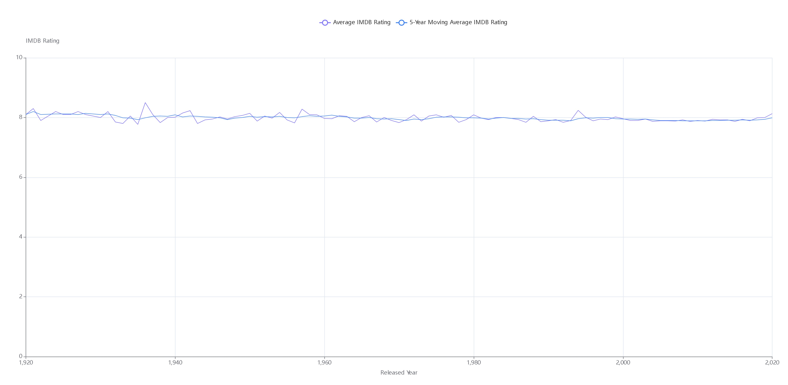

Slide 8
Correlations: IMDB, Meta, Votes, Revenue
Strongest Positive Correlation: No_of_Votes and Gross (0.57), indicating movies with more votes tend to have higher gross revenue.
Moderate Relationship: IMDB_Rating and No_of_Votes (0.49), suggesting popular movies often have better IMDB ratings.
Weak/Negligible Relationships: IMDB_Rating and Gross (0.10), Meta_score and Gross (-0.03), showing these ratings are not strong financial success indicators.

Slide 9
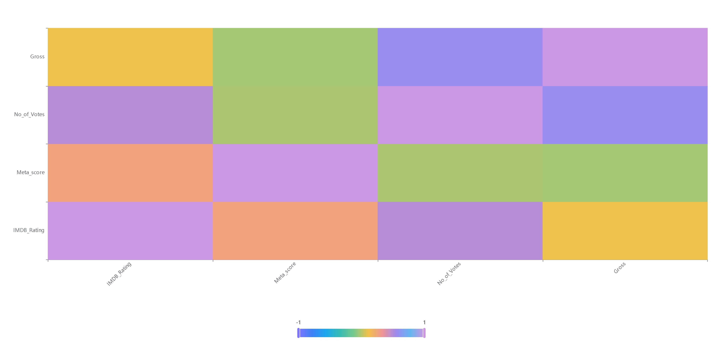

Slide 10
IMDB Movie Ratings Outliers IQR
Identified Outlier Movies: Movies like The Shawshank Redemption and The Godfather have IMDB ratings from 8.8 to 9.3, identified as statistical outliers.
Outlier Detection Method: Utilized the Interquartile Range (IQR) Method to classify outliers.
Conclusion: These high-rated outliers indicate a cluster of top-tier films with exceptional audience and critical reception.

Slide 11
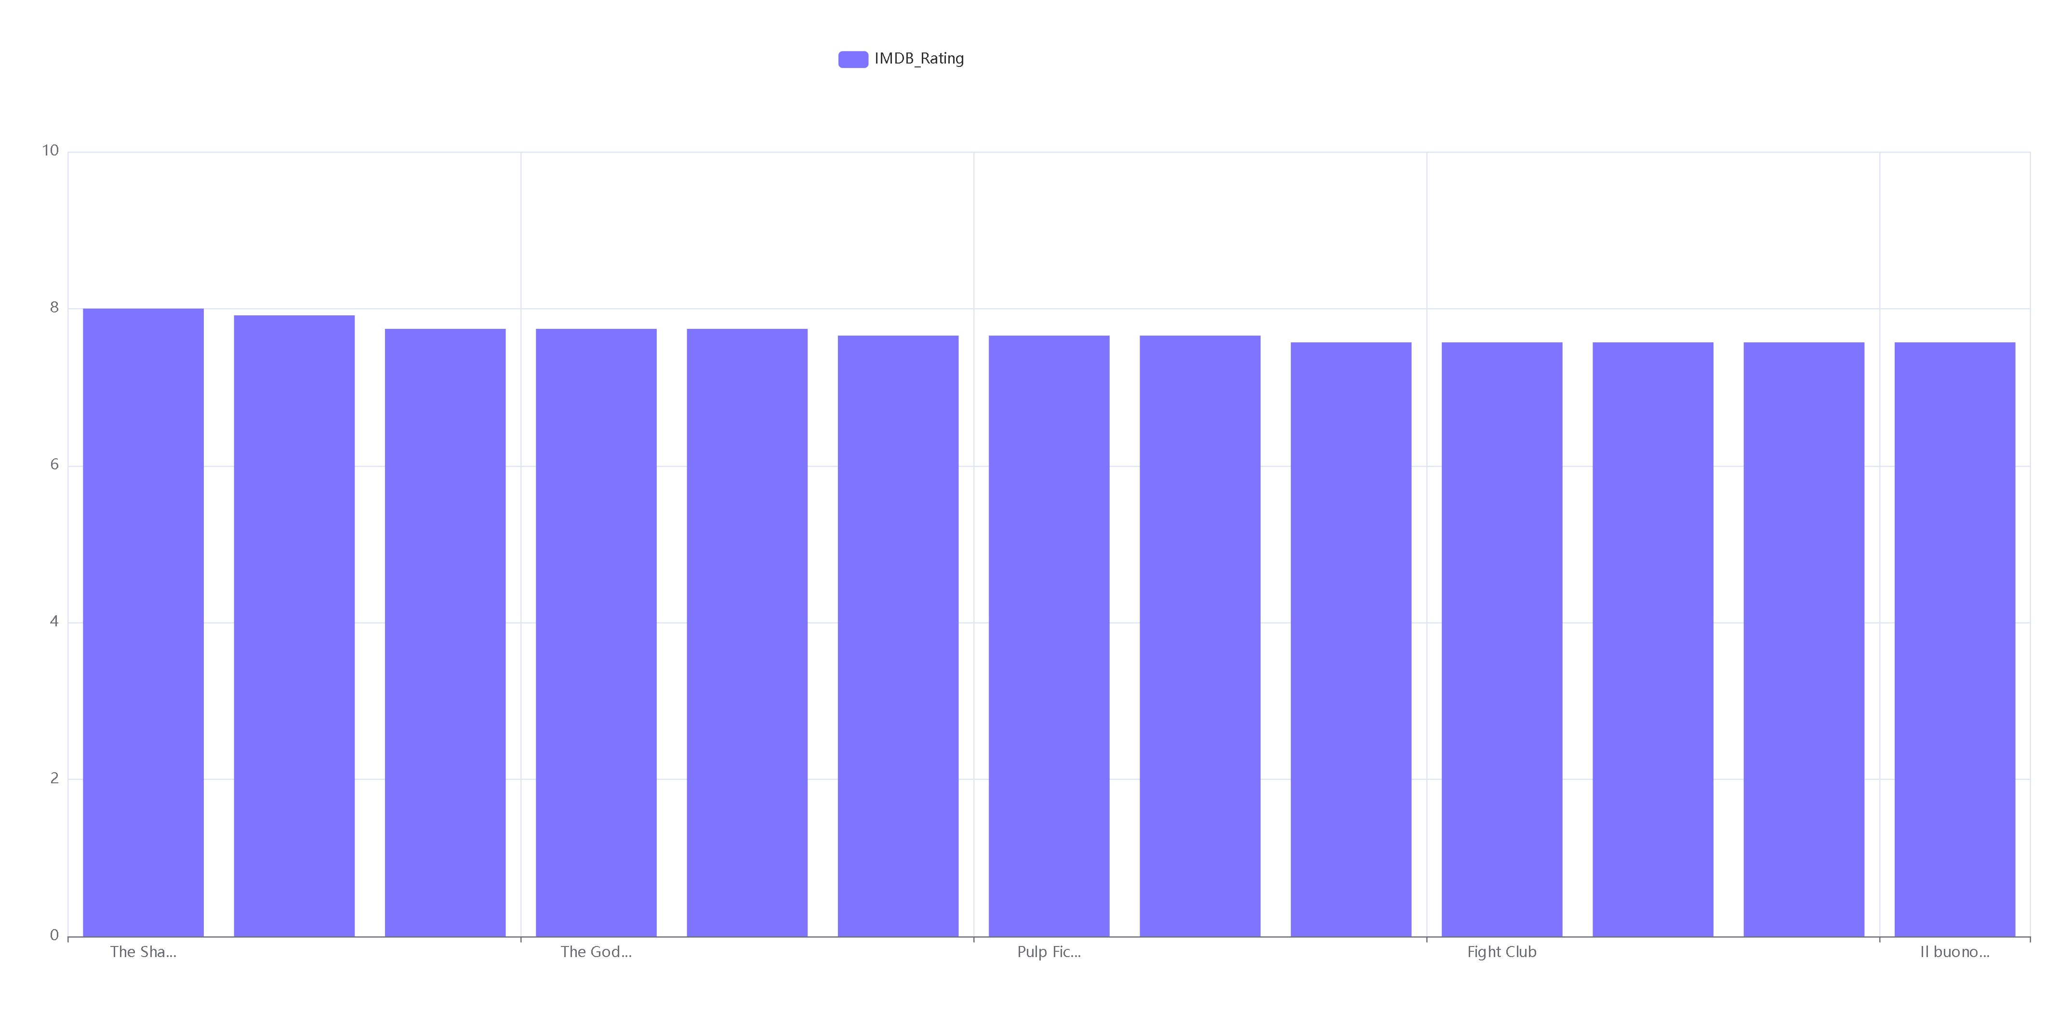

Slide 12
Average IMDB rating by genre
Top IMDB Ratings: Western (8.35), Crime (8.02), Fantasy (8.0).
Highest Gross Revenue: Family ($219.56M), despite lowest IMDB rating (7.8).
IMDB vs. Revenue: No direct correlation; Western has high rating but low revenue, Family the opposite.
Balanced Success: Action and Animation excel in both ratings and revenue.

Slide 13
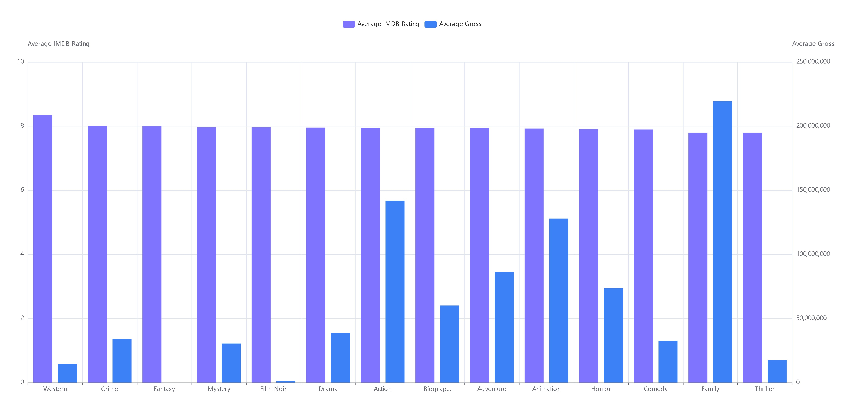

Slide 14
Top 10 Directors by Rating
High IMDB Ratings vs. Gross Revenue: Frank Darabont leads with an 8.95 IMDB rating but not the highest revenue. Roger Allers has the highest revenue at $422.78 million with a lower rating of 8.5.
Revenue Disparities: Revenues range from $7.56 million to $422.78 million, showing critical acclaim doesn't always equal commercial success.
Data Gaps: Missing revenue data for directors like Masaki Kobayashi limits financial comparisons.

Slide 15
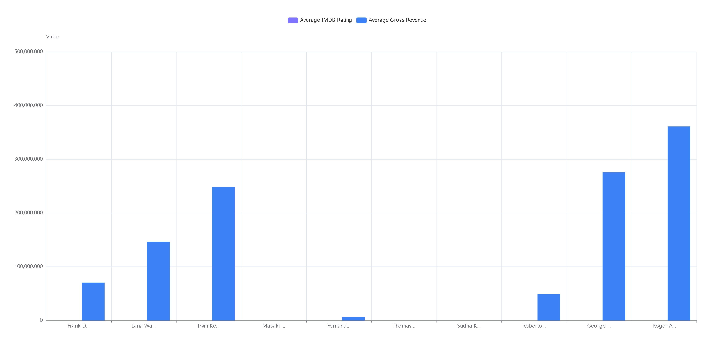

Slide 16
IMDB rating vs votes per actor
Average IMDB Ratings: Range from 7.60 to 9.30, with a mean of 7.93.
Votes and Ratings Relationship: No strong linear correlation; most movies have votes below 1,000,000 with ratings between 8.1 and 8.6.
Outliers: High vote counts (above 1.5 million) often correlate with high ratings (8.9 to 9.3).

Slide 17
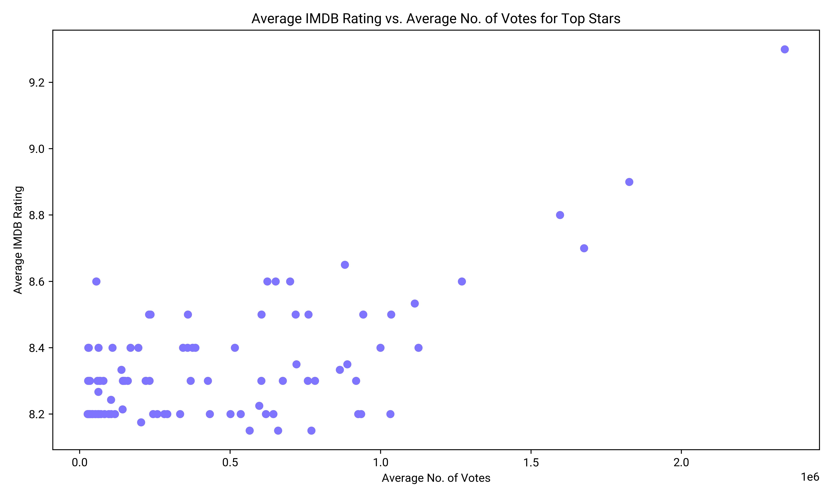

Slide 18
Average IMDB Rating by Certificate
Highest and Lowest Ratings: TV-14 has the highest average IMDB rating (8.3), while U/A has the lowest (7.6).
Certificate Distribution: U (234), A (197), and UA (175) are the most frequent certificates.
Rating vs. Popularity: High ratings in TV-14 and TV-MA may be outliers due to limited data.

Slide 19
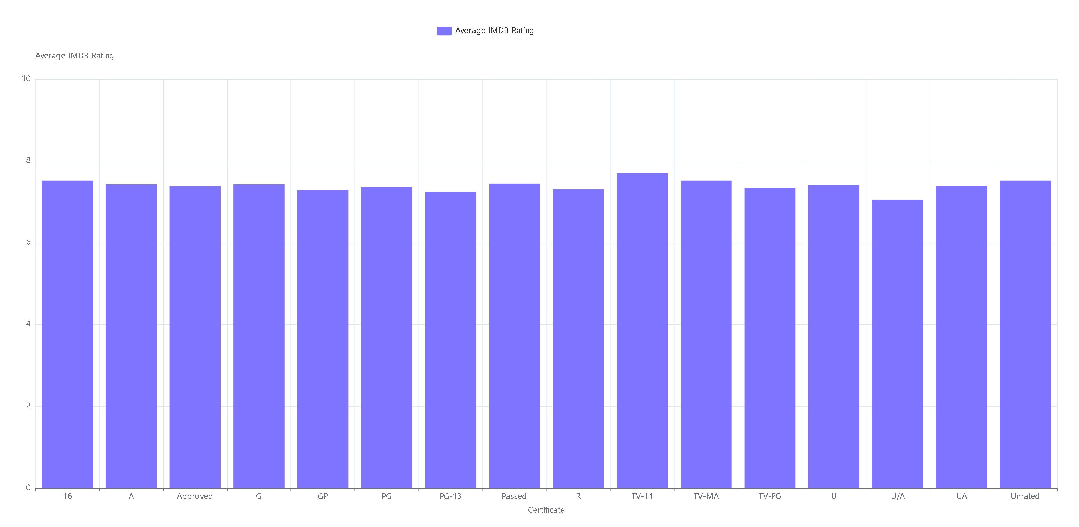

Slide 20
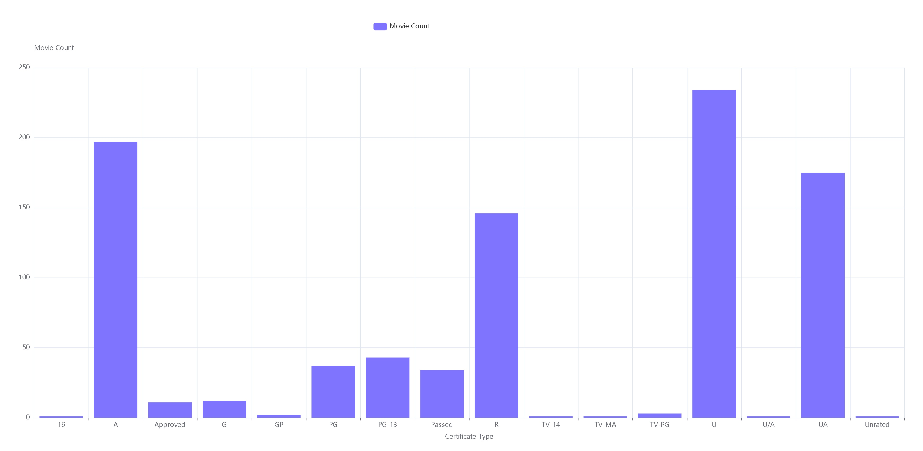

Slide 21
Movie runtime vs. IMDB rating
Pearson Correlation Coefficient: A weak positive linear relationship exists between 'Runtime' and 'IMDB_Rating' with a coefficient of 0.243.
Optimal Runtime Range: High-rated movies (IMDB ≥ 8.0) have runtimes between 45 and 321 minutes.
Conclusion: Longer movies might slightly correlate with higher ratings, but runtime is not a strong predictor of IMDB rating.

Slide 22
